Slide 1


Rx Hand Hygiene: Facilitating Clean Hands in Healthcare Facilities During COVID-19 and Beyond
May 2020

Slide 2

Opening Remarks
Ron Clemmer
Global Handwashing Partnership
FHI 360
Rx Hand Hygiene: Facilitating Clean Hands
Notes:
The run of show for today’s webinar will start with presentations by WHO, CDC, and the London School for Hygiene and Tropical Medicine. Then, presenters will have an opportunity to answer any questions. Following that, a panel discussion with representatives from USAID, Essity, HappyTap, and SPATAP will cover a range of solutions that can be used in low-resource settings to high-resources hospitals.

Slide 3
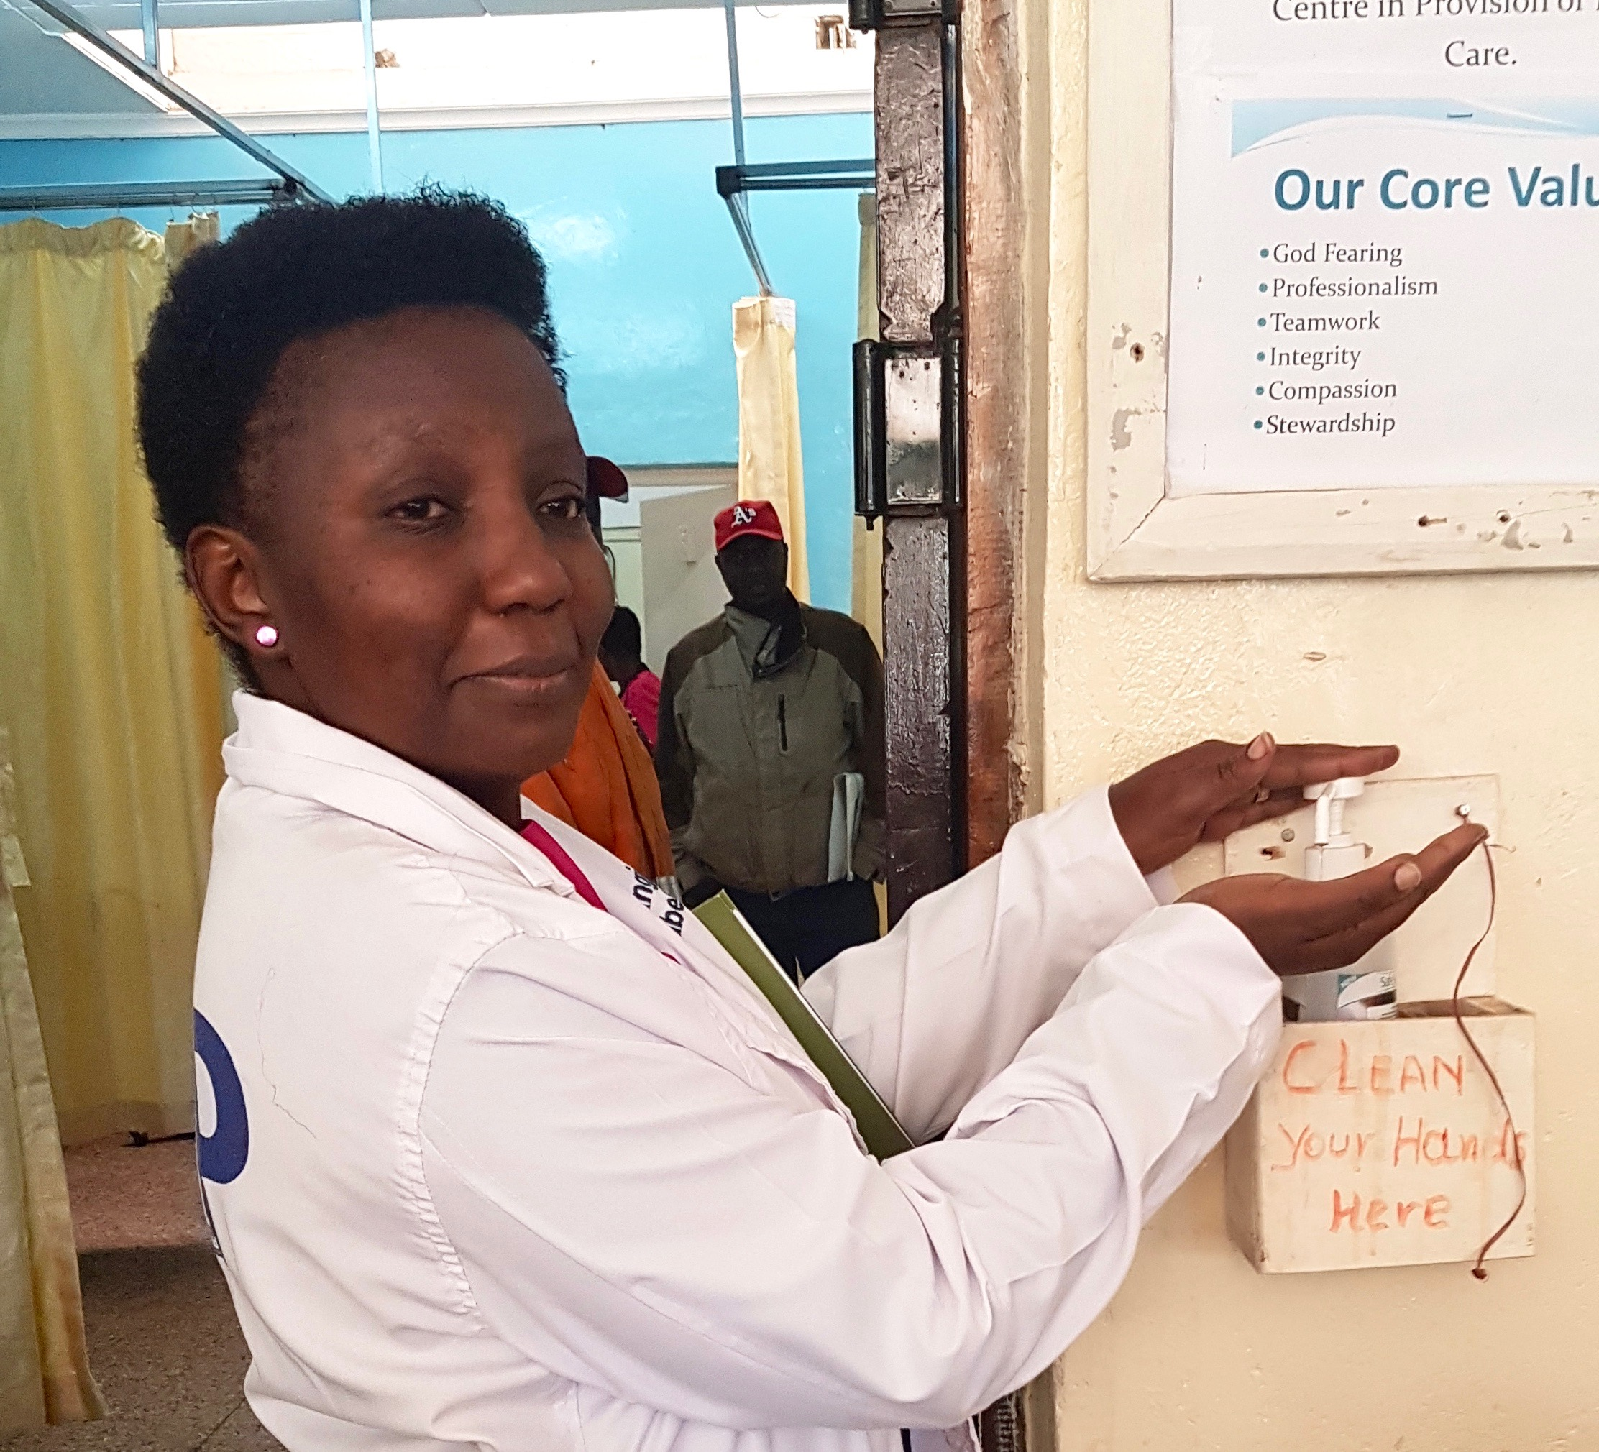
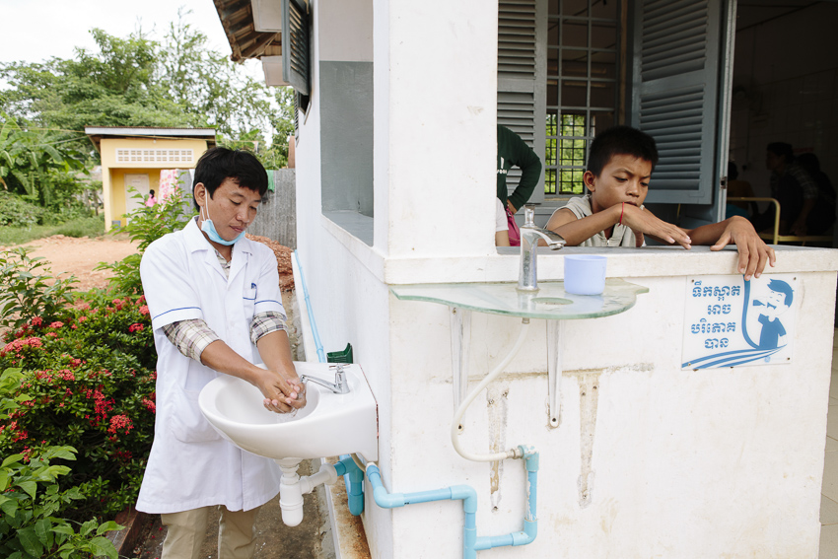
Webinar Objectives
Discuss the critical role of hand hygiene and other IPC measures in healthcare facilities
Address issues of hand recontamination
Provide practical solutions to increase access to hand hygiene facilities
Up Next: Technical Presentations

Slide 4


Presenters
Julie Storr
S3 Global, Consultant, WHO
Claire Kilpatrick
S3 Global, Consultant,
WHO
Rx Hand Hygiene: Facilitating Clean Hands

Slide 5

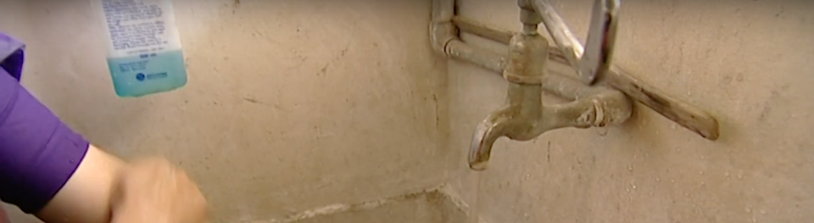
The need for hand hygiene in health care facilities
Claire Kilpatrick & Julie Storr
Consultants to WHO
7 May 2020

Slide 6
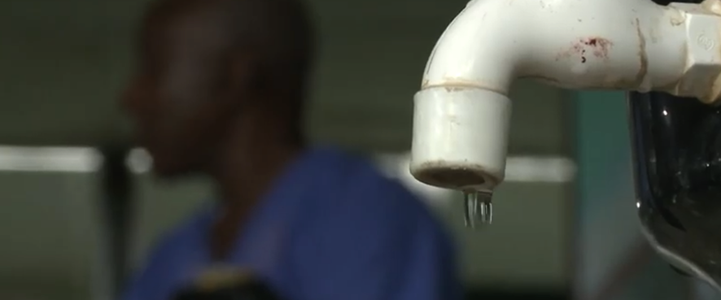
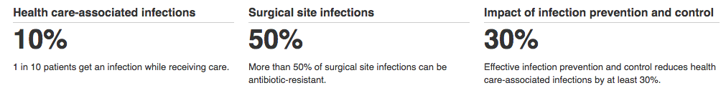

BREAKING NEWS
Live
We know the data
Hand hygiene in health care is a problem, it is sub optimal everywhere
May 7 2020
https://www.who.int/infection-prevention/publications/hh_evidence/en/

Slide 7
Five critical messages to convey now. The five golden rules for hand hygiene in health care
(right time)
1
Hand hygiene must be performed at the point-of-care*
2
During care delivery, there are five moments when it is essential to perform hand hygiene
Hand rubbing with an alcohol-based formulation, if available, makes hand hygiene possible at the point of care, is faster, more effective and better tolerated
3
(right technique)
4
Hand washing with soap and water is necessary when hands are visibly soiled (alternatives for LMICs are being suggested)
5
The appropriate technique and time taken to clean hands is also important
WHO Slides for Education Sessions for Trainers, Observers and Health-care Workers (revised May 2018)
https://www.who.int/infection-prevention/tools/hand-hygiene/training_education/en/
Notes:
This is a summary of the five golden rules, the rest of these slides provide more detail of these rules.

Slide 8
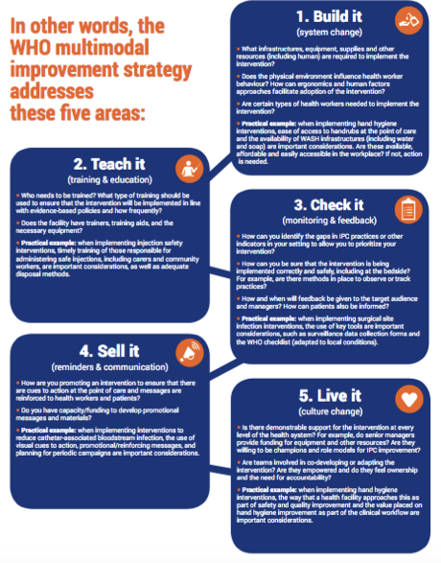
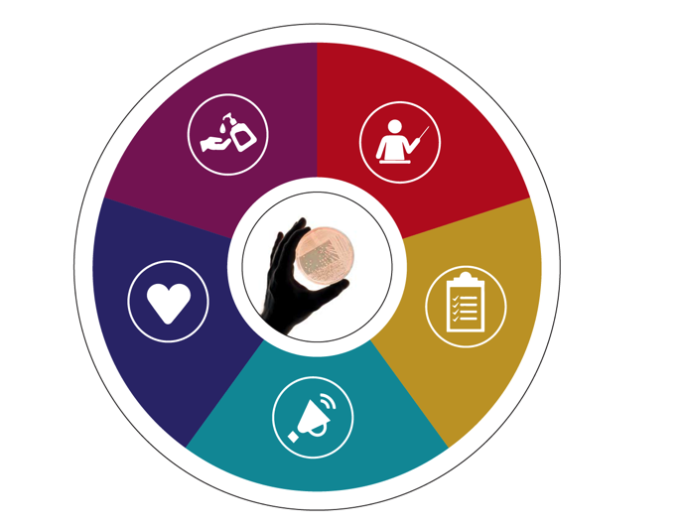
BREAKING NEWS
A proven approach is available
Live
Application of a multimodal strategy improves hand hygiene
May 7 2020
Notes:
What has WHO been promoting as a proven approach for over 10 years?

Slide 9

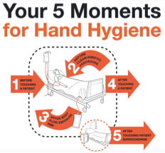


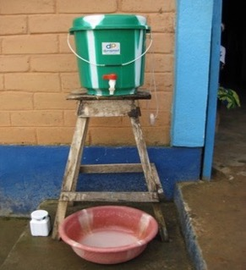
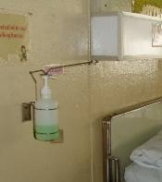
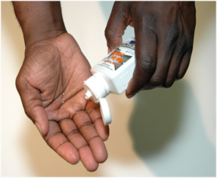
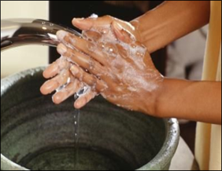
Build It - System change (infrastructure and resources)
Systems and procedures to procure, deliver and manage resources (including budget) are available (infrastructure - annual water service plan, supplies, policies)
In your facility, ask – can staff clean their hands easily at each (and every) point of care (reflecting the system is in place)?
WHAT MIGHT THIS LOOK LIKE IN A FACILITY?
An annual planned budget, which includes funding for infrastructure, services, personnel and the continuous procurement of hand hygiene products, annual water service plans and supplies to repair pipes, etc., which is sufficient to meet the needs of the facility in terms of WASH and IPC
Health care facility policies and SOPs which outline hand hygiene action and support WASH and IPC
Hand hygiene stations at all points of entry, points of care & within 5m of toilets (new WHO hand hygiene obligatory note) with reliable adequate supplies
Functioning hand hygiene stations in service areas and waste disposal areas
https://www.who.int/infection-prevention/tools/hand-hygiene/system_change/en/
Notes:
There are five elements of the multimodal strategy. This step explains what system change means.

Slide 10
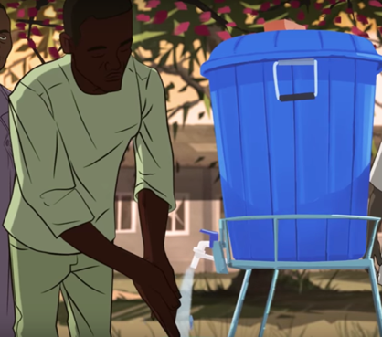
A new WHO recommendation making hand hygiene obligatory
NEW WHO OBLIGATORY HAND HYGIENE RECOMMENDATION
Recommendation to Member States to improve hand hygiene practices widely to help prevent the transmission of the COVID-19 virus:
Provide universal access to public hand hygiene stations and make their use obligatory on entering and leaving any public or private commercial building and any public transport facility.
Improve access to hand hygiene facilities and practices in health care facilities.
Interim recommendations on obligatory hand hygiene against transmission of COVID-19 https://www.who.int/who-documents-detail/interim-recommendations-on-obligatory-hand-hygiene-against-transmission-of-covid-19
Notes:
WHO recommends the following:
One or several hand hygiene stations (either for handwashing with soap and water or for hand rubbing with an alcohol-based hand rub ) should be placed in front of the entrance of every public (including schools and healthcare facilities) or private commercial building, to allow everyone to practice hand hygiene before entering and when leaving it.
Facilities should be provided at all transport locations, and especially at major bus and train stations, airports, and seaports.
The quantity and usability of the hand hygiene stations should be adapted to the type (e.g. young children, elderly, those with limited mobility) and number of users to better encourage use and reduce waiting time.
The installation, supervision, and regular refilling of the equipment should be the overall responsibility of public health authorities and delegated to building managers. Private sector and civil society initiatives to support the commodities, maintenance, and effective use are welcome.
The use of public hand hygiene stations should be obligatory before passing the threshold of the entrance to any building and to any means of public transport during the COVID-19 pandemic. Repeated hand hygiene whenever outside private homes can in this way become part of the routine of everyday life in all countries.
All private and public health care facilities should establish or strengthen their hand hygiene improvement multimodal programmes and rapidly ensure at a minimum procurement of adequate quantities of quality hand hygiene supplies, refresher hand hygiene training, and reminders and communications about the importance of hand hygiene in preventing the spread of the COVID-19 virus.
Local health authorities should ensure the continuous presence of functional hand hygiene stations (either alcohol-based hand rub dispensers or soap, water, and disposable towels) for all health care workers at all points of care, in areas where personal protective equipment (PPE) is put on or taken off, and where health care waste is handled. In addition, functional hand hygiene stations should be available for all patients, family members, and visitors, and within 5 m of toilets, as well as at entrances and exits, in waiting and dining rooms, and other public areas. Local production of alcohol-based hand rub formulations in national, sub-national or hospital pharmacies or by private companies should be strongly encouraged according to WHO guidance, especially if commercial options are limited or too costly.
Health care workers should perform hand hygiene using the proper technique and according to the instructions known as “My 5 moments for hand hygiene” , in particular, before putting on PPE and after removing it, when changing gloves, after any contact with a patient with suspected or confirmed COVID-19 virus, their waste, or the environment in the patients’ immediate surroundings, after contact with any respiratory secretions, before food preparation and eating, and after using the toilet.
All health care facilities are strongly encouraged to participate actively in the WHO Save Lives: Clean Your Hands campaign before and on 5 May 2020 and to respond to the United Nations Secretary General’s Global Call to Action on WASH in health care facilities.

Slide 11


Teach it – training & education
An up to date training package/materials with responsibilities allocated for execution, as well as a rolling schedule
In your facility, ask:
Who needs to be trained/educated to address gaps in knowledge and practice?
How will this happen and who will undertake the training/education?
Are training resources up-to-date and does training reinforce and embed the Five Moments for Hand Hygiene?
WHAT MIGHT THIS LOOK LIKE IN A FACILITY?
A range of tools/approaches used and a competent trainer
An accessible training schedule to suit staff rotas
Health care personnel new to the facility receive training as part of their orientation programme. Health care personnel are trained each year - the right time and the right technique
https://www.who.int/infection-prevention/tools/hand-hygiene/training_education/en/
Notes:
This step focuses on training and education.
Allocate responsibility to check that current training and education programmes include COVID-19 hand and respiratory hygiene recommendations - update where necessary - map guideline recommendations to training content
Put in place a reliable mechanism to update training resources on an ongoing basis
Identify the expertise required to conduct training (this may mean asking experts from other countries)
Undertake targeted training of frontline and waste staff (different approaches may be necessary) - prepare a schedule
Depending on the setting, prepare (and budget for) educational materials for patients and visitors
Provide direction/training materials on producing ABHR (pharmacy staff) if relevant

Slide 12



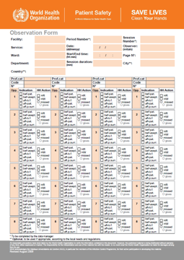
Check it – monitoring & feedback
The right things are in place to monitor and feedback on hand hygiene, including responsibilities and the use of valid tools
In your facility, ask:
Does the facility have dedicated trained staff to monitor hand hygiene resources, and compliance among a range of health workers?
Does the facility monitor hand hygiene perceptions and knowledge in a range of health workers?
How is feedback given to support improvement? How will the facility know that an improvement has taken place?
WHAT MIGHT THIS LOOK LIKE IN A FACILITY?
A hand hygiene monitoring schedule is available, with feedback posted to inform and motivate health care personnel
A schedule to assess the availability of handrub, soap, single use towels and other hand hygiene resources, with feedback to those who manage supplies to ensure timely replenishment
Use of WASH FIT and the WHO HHSAF to support the improvement journey
This WHO hand hygiene observation form checks compliance and provides feedback according to the Five Moments for hand hygiene
WHO Observation Form https://www.who.int/infection-prevention/tools/hand-hygiene/evaluation_feedback/en/
WHO Technical Reference Manual https://apps.who.int/iris/bitstream/handle/10665/44196/9789241598606_eng.pdf;jsessionid=535108637C3FCB039B3F9B4EB2589809?sequence=1
Notes:
Detailed instructions are available on the back of the observation form, to be consulted during observations and people should be trained in how to do this activity - a WHO manual and full slide set exists to achieve this.
Ask trainees what they think are some of the common challenges associated with auditing hand hygiene compliance?
Some of the common challenges reported include:
Securing support for audit from managers and leaders
Audit considered too time and resource consuming
Can you think of any others?
Discuss potential solutions and ask trainees whether they have any examples of how they have successfully implemented hand hygiene audits.
If WASH FIT is being implemented, it is likely that there will be some general support for associated audits, but there will still be a need for regular communication on the value of the data that will be generated. Hand hygiene audit results feed into the general facility improvement plan.

Slide 13



Sell it – communications & reminders
Development, issue and replacement of hand hygiene promotions through effective communications including posters and other reminders
In your facility, ask
What is the best way to publicize actions to support hand hygiene improvement?
Do you engage health care staff/ others to help produce a range of reminders?
Do the posters and reminders used reinforce and promote the Five Moments for Hand Hygiene related to the setting?
WHAT MIGHT THIS LOOK LIKE IN A FACILITY?
A range of hand hygiene promotion and educational materials clearly visible and understandable, at key places (and replaced on a scheduled basis)
Participation in hand hygiene campaigns
https://www.who.int/infection-prevention/tools/hand-hygiene/workplace_reminders/en/
Notes:
This step emphasizes communications and promotion. Promotion goes beyond posters. Campaigns are ways to promote hand hygiene, including radio campaigns, community campaigns, etc. Using leaflets in local languages can be useful, and messages on shirts and pin badges are sometimes used. Consider what works best in your setting.
Global campaigns aim to support local efforts to “sell hand hygiene” & change behaviours.
E.g. WHO’s SAVE LIVES: Clean Your Hands annual campaign helps to keep hand hygiene improvement efforts alive – global solidarity!

Slide 14
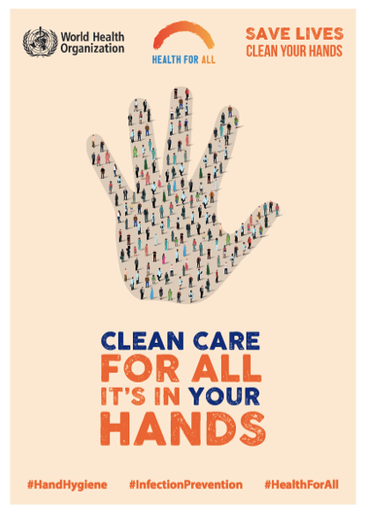
BREAKING NEWS
SAVE LIVES CLEAN YOUR HANDS 2020
Live
May 7 2020
Campaign launched in 2009.

Slide 15



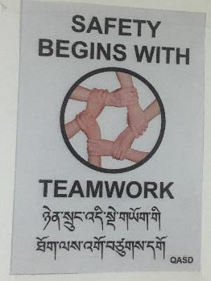
Live it – institutional safety climate (a safe culture)
Patients and staff “feel” safe and cared for in a hygienic environment that values the importance of hand hygiene at the right times
In your facility, ask:
How do you make and maintain hand hygiene as a facility priority? Is it discussed at senior management level?
How are senior managers, champions and opinion leaders engaged and engaging others over time?
Do all levels of staff, including senior managers and other leaders understand, role model and value the importance of the Five Moments for Hand Hygiene?
WHAT MIGHT THIS LOOK LIKE IN A FACILITY?
Training, monitoring and communication plans are supported (inc budget allocation)
Messages from leaders are visible/audible
Leaders are seen to attend training and role model hand hygiene as per the Five Moments
Staff have WASH and IPC related responsibilities and are appraised, with high performing staff recognized & rewarded and those who do not perform managed according to the local culture
What Women Want Global Findings – Image from White Ribbon Alliance (WhiteRibbonAlliance)
https://www.dropbox.com/sh/rcw1hn9dnqu1fpl/AAC0qON71SZULyRM3j_Xkd6da?dl=0 https://www.who.int/infection-prevention/tools/hand-hygiene/safety_climate/en/
Notes:
This slide discusses institutional culture.

Slide 16
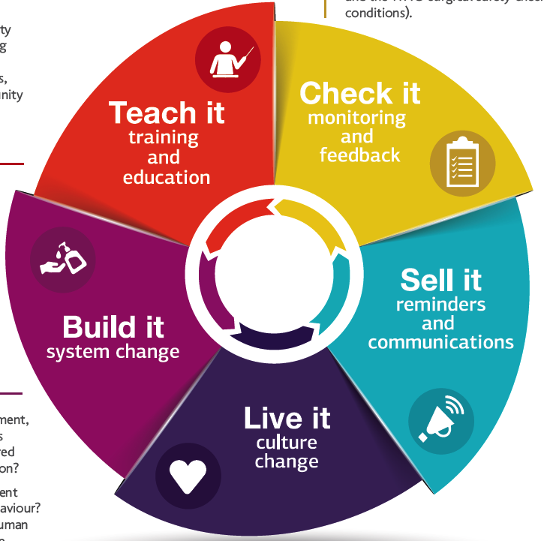

Slide 17
Resources
All WHO Hand hygiene tools and resources https://www.who.int/infection-prevention/tools/hand-hygiene/en/
New England Journal of Medicine hand hygiene video article (link to all available languages) http://www.who.int/gpsc/5may/hand_hygiene_video/en/
Hand Hygiene: A Handbook for Medical Professionals https://www.wiley.com/en-gb/Hand+Hygiene:+A+Handbook+for+Medical+Professionals-p-9781118846865
Some extra training ideas:
WHO IPC Training Package (e-learning) Standard Precautions: Hand Hygiene & Standard Precautions: Environmental Cleaning https://ipc.ghelearning.org/course/123
General IPC and AMR resources
WHO Minimum Requirements for infection prevention and control (IPC) programmes https://www.who.int/infection-prevention/publications/min-req-IPC-manual/en/
WHO Guidelines on core components of infection prevention and control programmes at the national and acute health care facility level https://www.who.int/infection-prevention/publications/ipc-components-guidelines/en/
WHO multimodal improvement strategy https://www.who.int/infection-prevention/publications/ipc-cc-mis.pdf?ua=1
Antimicrobial stewardship programmes in health-care facilities in low- and middle-income countries. A WHO practical toolkit https://apps.who.int/iris/rest/bitstreams/1257395/retrieve
WHO Antimicrobial resistance pages: https://www.who.int/health-topics/antimicrobial-resistance
COVID-19
https://www.who.int/emergencies/diseases/novel-coronavirus-2019/technical-guidance/health-workers
The 2020 campaign
https://www.who.int/infection-prevention/campaigns/clean-hands/en/
https://cleanhandssavelives.org/
https://www.who.int/docs/default-source/coronaviruse/who-hh-community-campaign-finalv3.pdf?sfvrsn=5f3731ef_2
Notes:
Key resources

Slide 18
THANK YOU

Slide 19


Presenters
Benjamin Park
Chief, International Infection Control Program,
CDC
Matthew Lozier
Lieutenant Commander, U.S. Public Health Service;
Epidemiologist, CDC
Rx Hand Hygiene: Facilitating Clean Hands

Slide 20
Infection Prevention and Control for COVID-19
May 7, 2020
Benjamin Park, MD
International Infection Control Program
Division of Healthcare Quality Promotion
Disclosures: None
Disclaimer: The opinion(s) expressed here are those of the author(s) and do not necessarily represent the official position of the US CDC

Slide 21
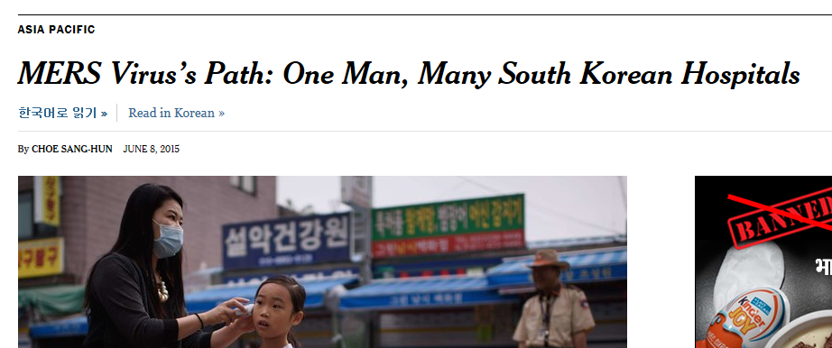
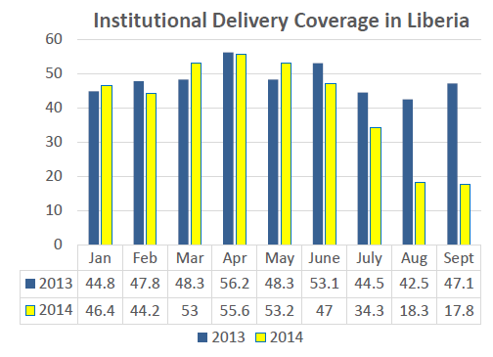
Why IPC During Epidemics?
Prevention of infections in healthcare settings
Safe provision of care: Critical piece in maintaining essential health services during epidemics
Fear, distrust, worry of healthcare settings
Ebola, MERS, COVID-19, etc.

Slide 22








IPC is a SPECIALTY
Facility
Hospital Administration
Public Health
IPC specialist
Facility
controls/
infrastructure
Surveillance and monitoring
HCW
monitoring
HCW
training
PPE / supplies

Slide 23
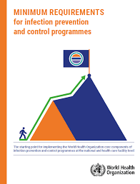
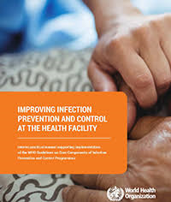
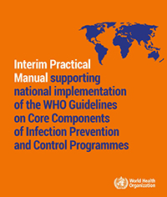
IPC in “Peacetime”
https://www.who.int/infection-prevention/tools/core-components/en/
https://www.who.int/infection-prevention/publications/min-req-IPC-manual/en/

Slide 24
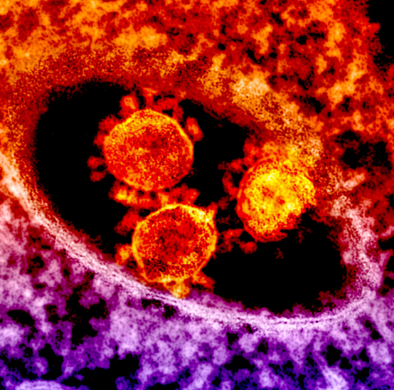
Pillars of COVID-19 IPC
Goal: To support the maintenance of essential healthcare services by preventing healthcare-associated transmission of SARS-CoV-2 among healthcare workers and patients
Limit unrecognized entry of COVID-19:
TRIAGE patients
LIMIT visitors
MONITOR staff
Prevent transmission
TRAIN staff (and provide supplies)
Rapidly identify nosocomial transmission:
DETECT nosocomial transmission
CONTAIN outbreaks before they spread

Slide 25
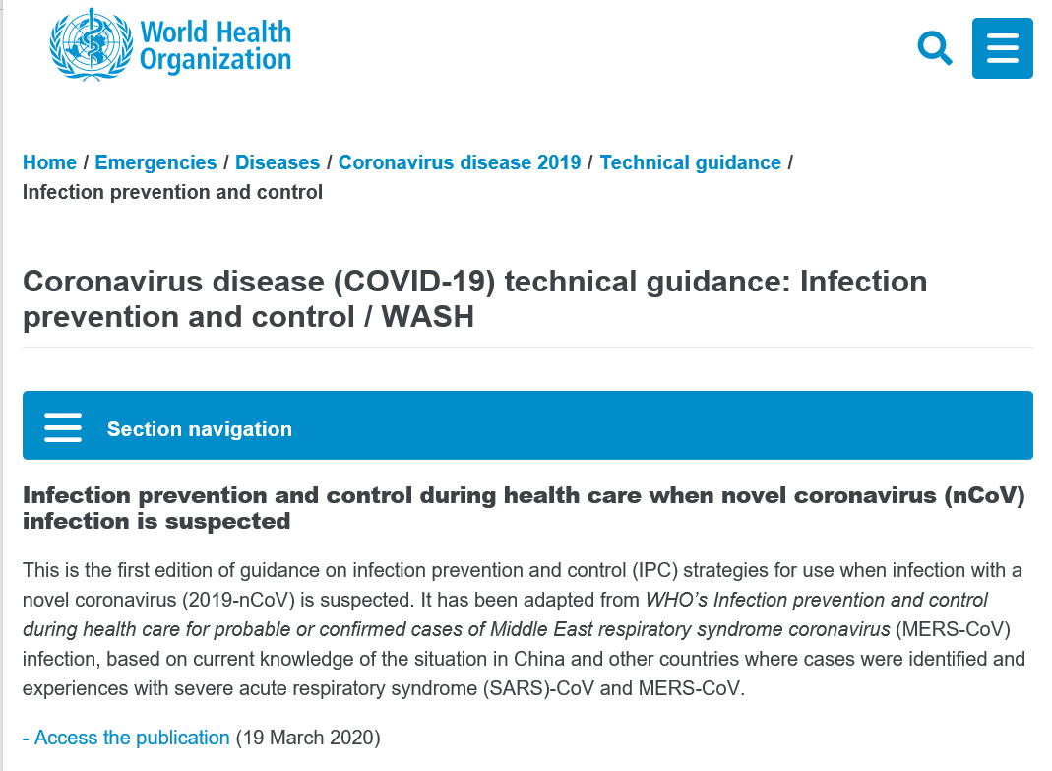
Guidance and Operational Considerations
https://www.cdc.gov/coronavirus/2019-ncov/hcp/non-us-settings/index.html
https://www.who.int/emergencies/diseases/novel-coronavirus-2019/technical-guidance/infection-prevention-and-control

Slide 26
Hand hygiene guidance
Triage areas
Hand hygiene facilities for patients upon arrival (triage and waiting area)
Training:
How to perform hand hygiene
Maintain appropriate distance
Advise patients on the use of facemask, hand hygiene, and separation from other patients
Inpatient areas
Hand hygiene facilities according to standards of care

Slide 27
CDC COVID-19 IPC Webinar series
Tentative launch week of May 12
CDC/ WHO collaboration
Example topics
Triage
Risk assessment and monitoring
Emergency strategies for PPE use
SARI treatment centers
Cleaning and disinfection
WASH considerations

Slide 28
Resources
CDC’s email campaign:
https://tools.cdc.gov/CampaignProxyService/subscriptions.aspx
For more information on COVID-19, for non-US healthcare settings, please visit https://www.cdc.gov/coronavirus/2019-ncov/hcp/non-us-settings/index.html.

Slide 29
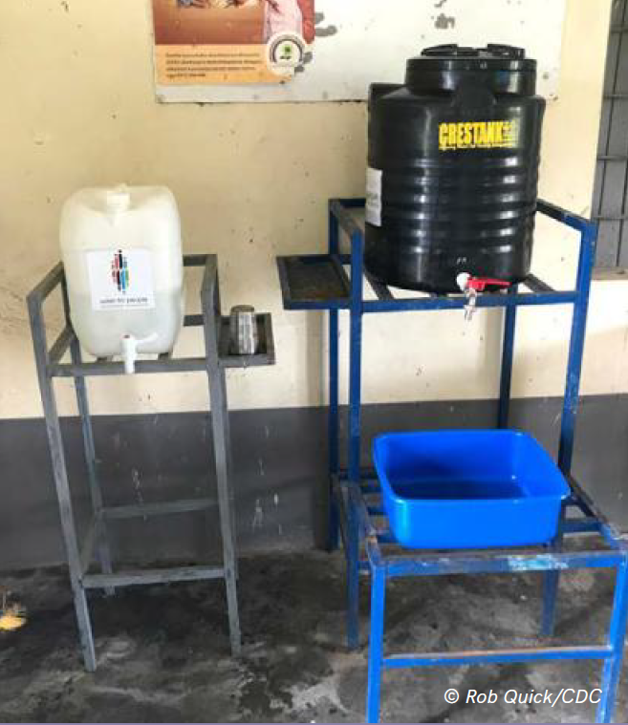
Practical actions to increase access to hand hygiene resources
May 7, 2020
Matthew Lozier, PhD
Global WASH Epidemiology Team
Division of Foodborne, Waterborne, and
Environmental Diseases
Notes:
Hand hygiene adherence of healthcare workers is a critical component of a comprehensive infection, prevention, and control program.

Slide 30
Disclaimer
The findings and conclusions in this report are those of the author and do not necessarily represent the official position of the U.S. Centers for Disease Control and Prevention.

Slide 31

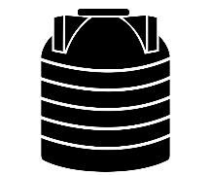


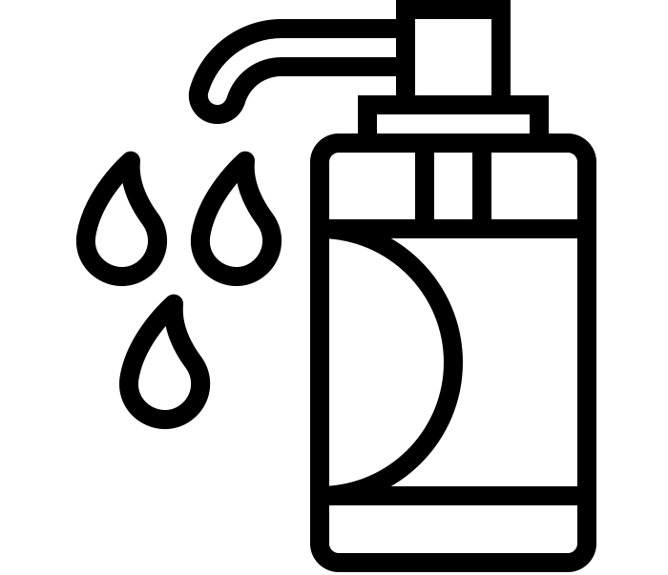
Outline
Rapid assessment
Handwashing stations
Alcohol-based hand rub (ABHR)
Notes:
There is a lot of messaging about the importance of hand hygiene in the healthcare setting, but if healthcare workers do not have access to the necessary hand hygiene resources, they will not be able to adhere to hand hygiene guidelines.

Slide 32
Rapid assessment of hand hygiene resources
Location is key! Hand hygiene resources should be placed:
At the healthcare facility entrance
Where providers have patient contact or contact with specimens or medications
At latrines
Having hand washing resources makes you 50% more likely to wash your hands*
Conveniently located hand washing resources with soap and water make you 80% more likely to practice hand washing*
* https://s3.eu-west-2.amazonaws.com/washem-assets-prod/documents/washem_quicktip_handwashingdesign.pdf
Notes:
The key to hand hygiene resources in healthcare settings is location. Being able to perform hand hygiene at the appropriate times and in the appropriate places are critical. Handwashing resources should be placed at the healthcare facility entrance, at each location where providers have patient contact or contact with specimens or medications, and at latrines. Evidence has shown that presence of hand washing resources makes you 50% more likely to wash your hand and that conveniently located hand washing resources with soap and water make you 80% more likely to practice hand washing.

Slide 33


















Methods: Observation of Patient Care Areas
Latrine
Adult Ward
Children’s Ward
Maternity Ward
Labor and Delivery
Latrine
Waiting Area
Pharmacy
Outpatient
Department
Lab
Director’s
Office
Notes:
Here you can see an example of a small healthcare facility and where it needs hand washing resources. As you can see, hand washing resources are needed in each of the patient wards, the labor and delivery area, as well as the lab, the outpatient department, and the pharmacy. Hand washing resources are also needed at the entrance to the facility and near the latrines.
In this case, the HCF needs 9 hand washing resources.

Slide 34
Handwashing stations

Slide 35
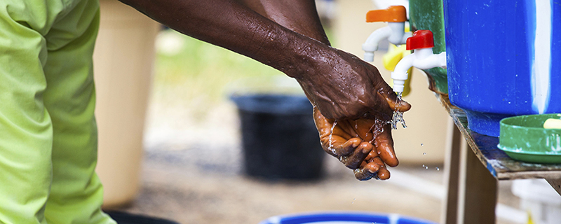
Hand washing stations
Water availability
Soap availability
Soap dispenser
User friendly
Durable
Locally available products
Local repair
Funding for repairs
Who will maintain?
Notes:
There are many different hand washing station designs and products out there, but this slide showcases handwashing station considerations you need to take into account for any specific healthcare setting. It is important to make sure that adequate water and soap is available for hand washing stations. The design of the hand washing station must include an area for soap. The design must also be user friendly and durable.
Local products should be incorporated into the design. This will help with production and with maintenance when the hand washing stations need repair. Regarding repairs, who will pay for repairs and do they have a budget to pay for them? Last, it is critical to consider who at the healthcare facility is responsible for maintenance. Hand washing stations usually need to be refilled daily and soap will need to be replenished, so it is important that there is a staff person dedicated to these tasks.
All of these considerations should be addressed with local partners before simply purchasing and distributing a hand washing station technology.

Slide 36
Resources
“How to design handwashing facilities that change behaviour”
https://s3.eu-west-2.amazonaws.com/washem-assets-prod/documents/washem_quicktip_handwashingdesign.pdf
“Handwashing compendium for Low Resource Settings: A Living Document”
https://opendocs.ids.ac.uk/opendocs/bitstream/handle/20.500.12413/15241/Handwashing_Compendium_for_Low_Cost_Settings_Edition_1.pdf?sequence=1&isAllowed=y
“Water, Sanitation, and Hygiene in Health Care Facilities – Practical Steps to Achieve Universal Access to Quality Care”
https://www.washinhcf.org/wp-content/uploads/2019/04/2019_WASH-in-HCF-Practical-Solutions-for-Universal-Access-to-Quality-Care_2April-compressed.pdf
“COVID-19 Handwashing With Soap (HWWS) Facilities – Compendium of Indicative Layouts, Designs and Cost Estimates”
http://www.fountainheadsolution.com/draft/covid19/mobile/index.html
Notes:
Key resources. The first one helps tackle this issue with overarching questions about hand washing stations, while the second one presents specific technologies and includes the advantages and disadvantages of each.

Slide 37
Alcohol-based hand rub (ABHR)
Notes:
While ABHR is available commercially, the next few slides will discuss implementation of programs to produce ABHR for local distribution and use.

Slide 38

Facility-based production
Successful in large referral hospitals.
Able to order own supplies
Can estimate consumption rates and produce ABHR without a break in service.
Have the right technical cadre to support continuity in production
Notes:
One model for ABHR production is facility-based. This model has been successful in large regional and national referral hospitals in low-resource settings. These hospitals can order their own supplies, can estimate their consumption rates more accurately, and have the technical expertise and physical resources to support ABHR production.

Slide 39
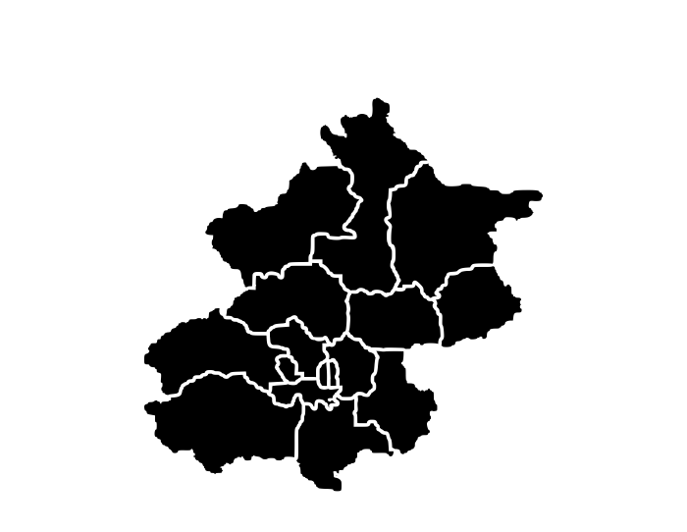
District-based production
Could work better for smaller health facilities
Rarely have the cadre to support production.
Lack of space for ABHR production unit.
Have difficulty procuring raw materials
Notes:
A new model that has been explored in Uganda is a distract-based model. This model could work better for smaller healthcare facilities, which rarely have their own technical resources or physical space for an ABHR production unit. They also may have difficulty procuring raw materials.

Slide 40
WHO Formulations* – how to make ABHR
Ingredients
Ethanol 96%
Hydrogen Peroxide 3%
Glycerol 98%
Sterile distilled water
* https://www.who.int/gpsc/5may/Guide_to_Local_Production.pdf?ua=1
Notes:
The program in Uganda used the ethanol-based WHO formulation. Ingredients include ethanol, hydrogen peroxide, glycerol and sterile distilled water. Standard laboratory supplies are used for mixing batches of ABHR.

Slide 41
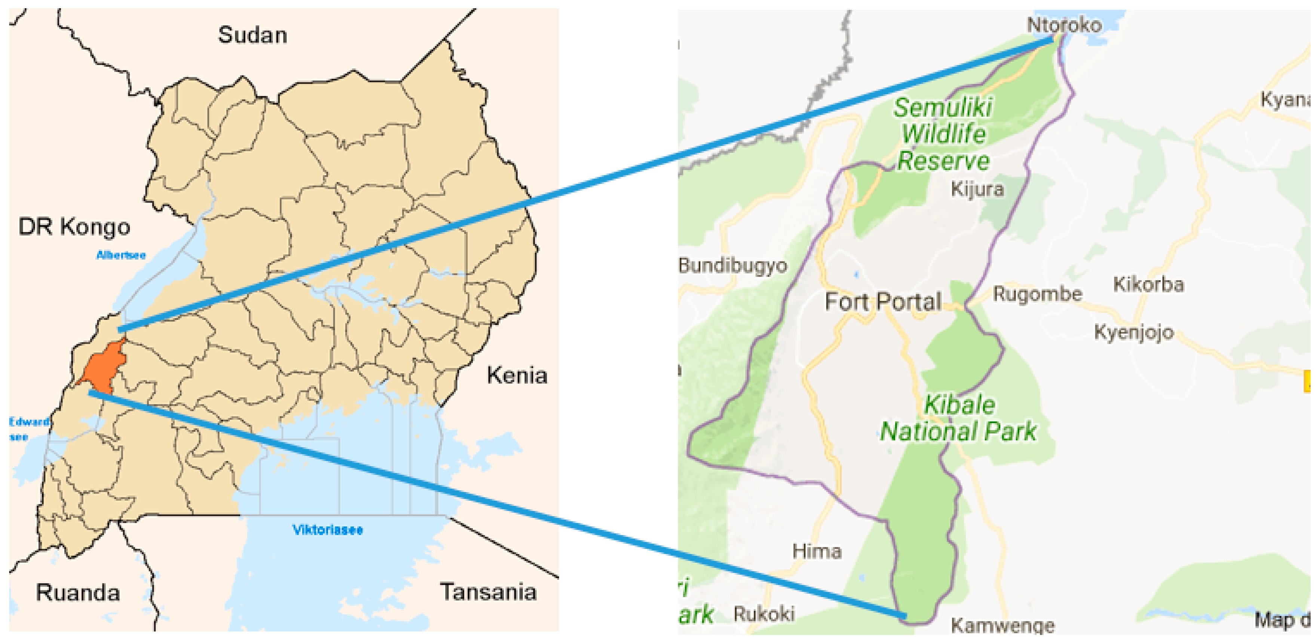
Kabarole District, Uganda
District health officials dedicated space for ABHR production
ABHR produced in 20-liter batches
30 government healthcare facilities received 20-liter jerrycans of ABHR
1-liter pump bottles at each patient care area
60mL bottles to healthcare workers
Notes:
Kabarole District is located in western Uganda. District health officials were engaged from the beginning and they dedicated space for a centrally located ABHR production unit. There, ABHR was produced in 20 liter batches and stored in 20 liter jerrycans. Next, each of the 30 government healthcare centers received a 20 liter jerrycan of ABHR. Each healthcare center had assessed their facilities and received enough 1 liter pump bottles so that each patient care area had a 1 liter bottle of ABHR. Last, each healthcare worker received a 60mL bottle that they could refill at the 1 liter bottles and carry with them throughout the healthcare center.

Slide 42
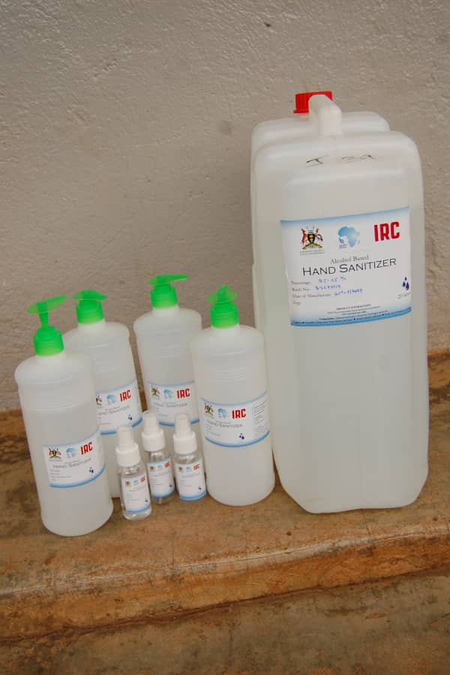
Key Considerations
Partner engagement
Ministry of Health, Local health officials
Infectious Disease Institute
International Water Sanitation Centre – WASH (IRC-WASH)
Quality Control
Packaging
Distribution
Existing distribution routes
Notes:
This program in Kabarole has been ongoing for more than 1 year and observed a significant increase in hand hygiene adherence among healthcare workers. Key considerations in implementing this program were engaging partners during the development of the program. We worked closely with the district health authorities and 2 implementing partners, the Infectious Disease Institute of Makerere University and IRC-WASH.
The program included a robust quality control system that included internal and independent external quality checks on the ABHR after it was produced and before it was distributed.
It was important to take into account the local context to determine what type of packaging material to use. We distributed 20 liter jerrycans to HCF so that they would have an adequate supply for several weeks or months. In different settings, different packaging may be warranted.
The program budgeted for ABHR distribution so that we could ensure a constant supply and evaluate the impact of ABHR on hand hygiene adherence. However, hired distribution was expensive and unsustainable. A more sustainable approach could be to leverage existing medical distribution systems for ABHR.

Slide 43
Summary
Assess healthcare facilities
Identify gaps
Identify intervention
Handwashing stations with soap
Locally produced ABHR
https://www.youtube.com/watch?v=M7rR6RZoONA
Notes:
In summary, it is important to assess the needs of the healthcare facility to identify gaps. With that data you can then work with local partners to identify the best strategy to improve access to hand hygiene resources. Hand washing stations with soap and water and locally produced ABHR programs can improve access to hand hygiene resources and help increase hand hygiene adherence, but many considerations must be addressed to make the intervention more successful.
A recording of a one-hour webinar that goes into more details about the ABHR project in Uganda can be found at the link on the slide.

Slide 44



Acknowledgements
Infectious Disease Institute of Makerere University
Uganda Ministry of Health
International Water Sanitation Centre – WASH (IRC-WASH)

Slide 45

Presenter
Giorgia Gon
Assistant Professor, Department of Infectious Disease Epidemiology,
London School of Hygiene and Tropical Medicine
Rx Hand Hygiene: Facilitating Clean Hands

Slide 46
Hand recontamination – the missing piece in hand hygiene Evidence from labour wards
Giorgia Gon

Slide 47
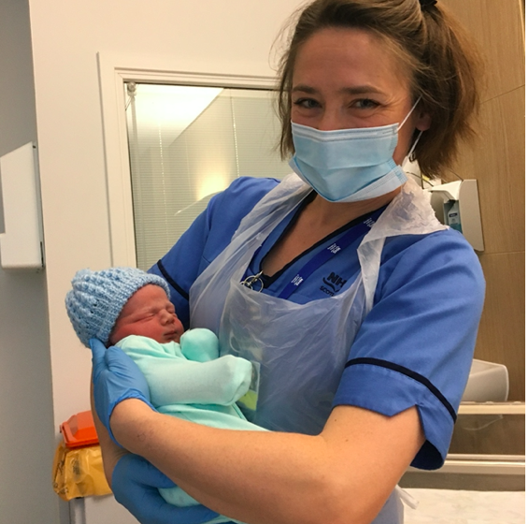

Slide 48
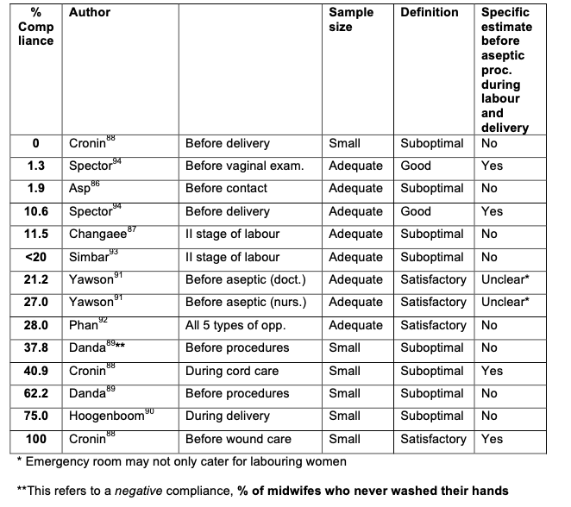
Hand hygiene during labour & delivery
Systematic review : 24th of April 2018 ; EMBASE, MEDLINE, CINHAL and the WHO regional databases
Hand hygiene and maternity ward terms , restricted to LMICs
From 526 titles to 9 full texts included

Slide 49

Current measurement tools & challenges
What is the sampling strategy for observation and facilities visits
Methods for ensuring quality during data collection
The inter-observer agreement
The definition of hand hygiene
Patient zone
Notes:
Definition following the WHO hand hygiene guidelines (i.e. soap necessary for hand washing; which type of hand hygiene opportunity e.g. before vs. after, touching intact skin vs. aseptic procedure; denominator based on patient-worker interactions rather than individual or group level performance);

Slide 50

Time-and-motion study
Getty images
Notes:
Used in HIC, very rarely in low resource settings
Image from> https://www.gettyimages.co.uk/illustrations/nosy

Slide 51
Time-and-motion study: interface
Concealment…

Slide 52
Sampling visits and attendants
10 high-volume facilities across Unguja and Pemba islands, Tanzania
Hospital visits : 24h, for 6 consecutive days
Observers: nurse-midwives working in managerial roles
Observers continuously present across entire shit
Observer-attendant pairs assigned to ensure habituation
Inter-observer agreement - kappa statistic: 0.93, 0.90, 0.73; compliance did not vary by observer
Study participants: all present during observation; all women; 90% formally trained
Focus on those responsible for labour and delivery (using roster, team meeting info)
Notes:
To obtain representative data on deliveries across all shifts (morning, afternoon and night); three observers, one per shift, conducted observations that covered 24h a day. They observed for a total of 130 hours in the morning, 153 hours in the afternoon and 205 hours in the night. Each observer had their own tablet for data collection. Each facility was visited for a mode of six consecutive days (range: 5-14 days) between the 17th of September and 31st of December 2016. The order in which we visited the facilities was chosen based on logistics considerations. We arranged for additional days of observation in one facility with a high volume of staff to allow all staff to be observed and in three facilities with low volume of deliveries to capture a sufficient number of procedures.

Slide 53
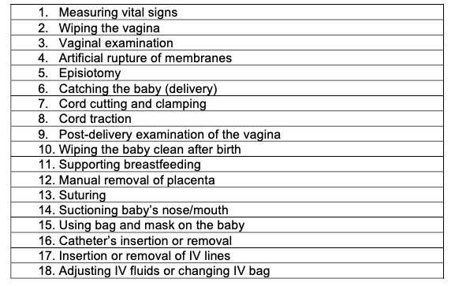
Patient-attendant interactions
Notes:
Observers were encouraged to take breaks when there were no women in labour or with women very early stages of labour, and to have their break in locations where they could see if an emergency admission occurred to avoid missing delivery events. We also encouraged breaks if the observer’s concentration level was low.
To ensure quality of data collection, we held regular meetings with collectors over the telephone and onsite; set up and frequently communicated via a WhatsApp group; held Skype calls at the end of observations in each facility; and monitored monthly the data uploaded. These communication channels enabled rapid feedback, questions to be answered, and maintenance of morale during long periods of observation. Drivers ensured observers arrived at sites on time. Finally, we are confident that the data is unlikely to be manufactured because it would take as much time to manufacture time- stamped data as to create it from actual observation because the time stamp of each entry is recorded.

Slide 54
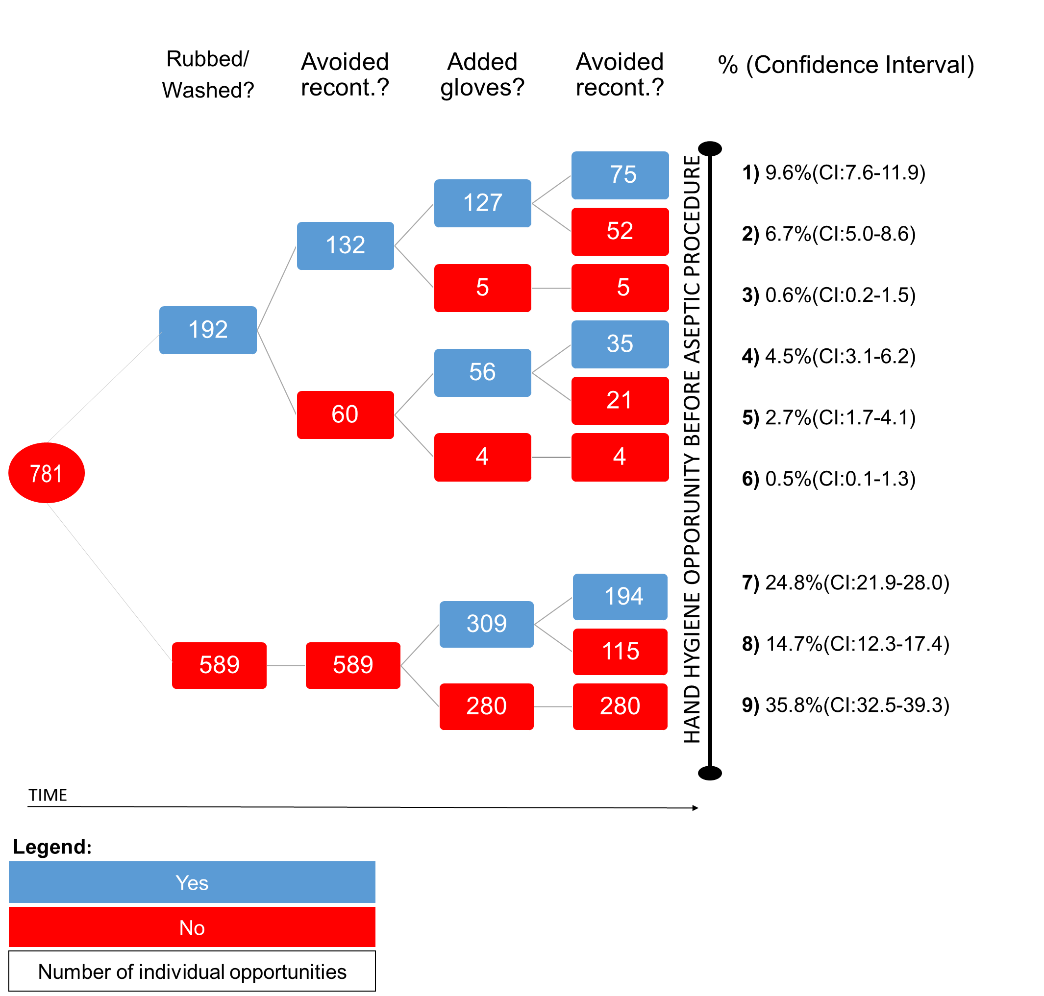
Results: hand hygiene before aseptic procedures
Hand/glove recontamination
104 birth attendants
- 10 labour wards
227/501 =45%

Slide 55



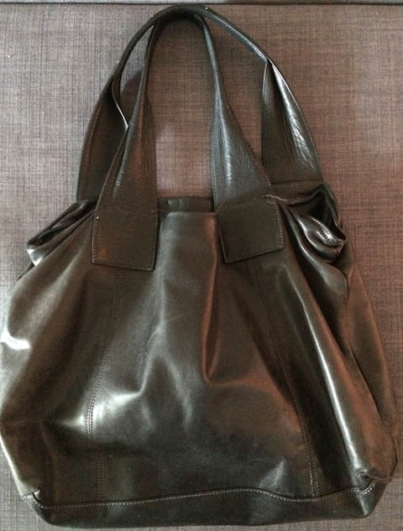
Recontamination: on which surfaces?
20.5%
Hands
Gloves
47.4%
9.0%
OTHER
16.7%
56.0%
21.9%
2.2%
5.1%
20.0%
1.3%

Slide 56

Recontamination in the literature
“Privacy curtains”
Wilson et al (UK)
Stewardson et al (Australia emergency departments)
“Our findings show 92% of staff turn on elbow operated outlets with their hands”, HIS, Weinbren, (UK)
“frequent breaks in technique included … the midwife’s gloved hands touching the patient’s bed, leg, abdomen, and perineal pad before the delivery.”
Cronin et al. (Ghana)
Notes:
Cronin WA, Quansah MG, Larson E. Obstetric infection control in a developing
country. J Obstet Gynecol Neonatal Nurs JOGNN. 1993 Apr;22(2):137–44.
Loftus et al. demonstrated microbiological recontamination of hands at the point of care
despite high levels of self-reported HH compliance, indicating the relevance of
recontamination in infection transmission.
ethnography which includes the perception of certain surfaces potentially leading to cross-transmission or not.
Wilson J, Prieto J, Singleton J, O’Connor V, Lynam S, Loveday H. The misuse
and overuse of non-sterile gloves: application of an audit tool to define the
problem. J Infect Prev. 2015 Jan;16(1):24–31.
Stewardson AJ, Stuart RL, Egerton-Warburton D, Marshall C, van den Driesen M,
Havers S, et al. Determinants of hand hygiene behavior in Australian emergency
departments. In Antimicrobial Resistance and Infection Control; 2017. (Meeting
Abstracts; vol. 6(Suppl 3):52).

Slide 57
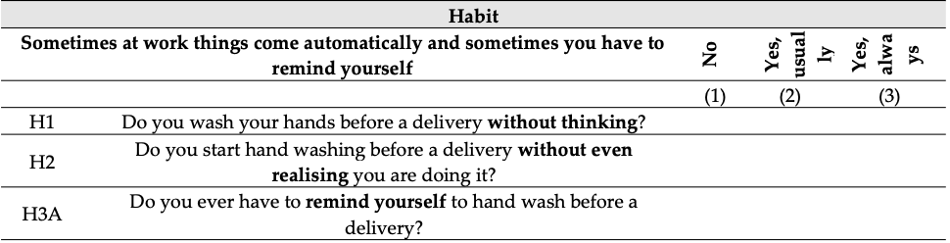
Survey – behavioural determinants, demographics
Notes:
Bicchieri – norms
Habit - gardner

Slide 58
Results: determinants
Multivariate, multilevel model controlling for several confounders...
HH:
Single-use drying material (OR:2.9; CI:1.58–5.14)
Lower workload (OR:29.4; CI:12.9–67.0)
More knowledge (OR:1.89; CI:1.02–3.49)
Environment with more reminders from colleagues (OR:1.20; CI:0.98–1.46)
Glove Recontamination:
Length of time elapsed since donning gloves (OR:4.5; CI:2.5–8.0)
Are they separate behaviours then?
Notes:
attitudes, norms, habit, infrastructure/supplies, professional cadre, refresher training, years since training, years in maternity, presence of the in-charge.
Multivariate, multilevel model which controlled for attitudes, norms, habit, infrastructure for HH, professional cadre, refresher training, years since training, years in maternity, presence of the in-charge.
We constructed a proxy for workload, which was defined as the number of procedures conducted per minute in the interval between the start of the observation session and the opportunity of interest. Workload was categorised into five quintiles.

Slide 59
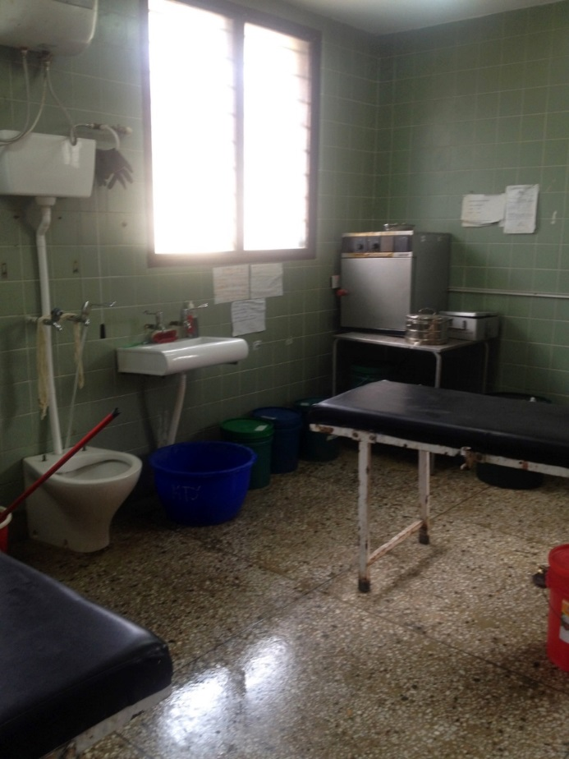
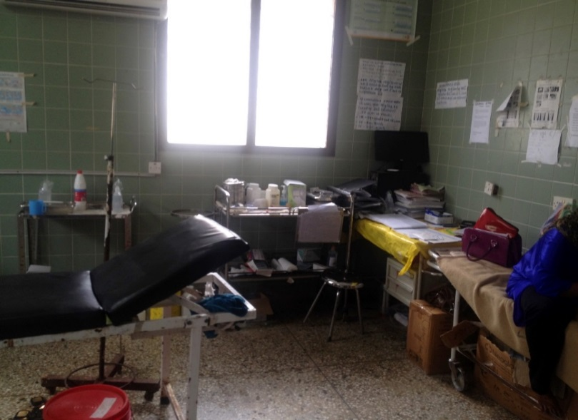
Why is recontamination particularly important at birth?
Mother and baby
24/7
A stochastic event
Complicated/uncomplicated
Surgery/wounds/body fluids
Notes:
Increasingly more important now that more and more women attend deliveries in facilities

Slide 60
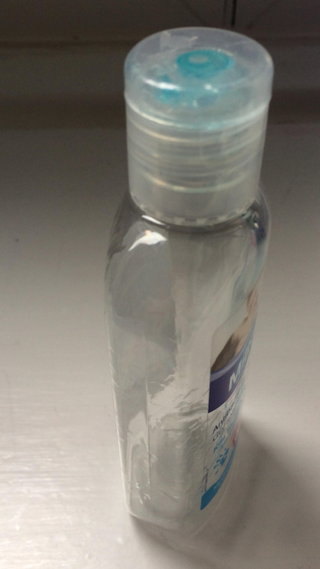
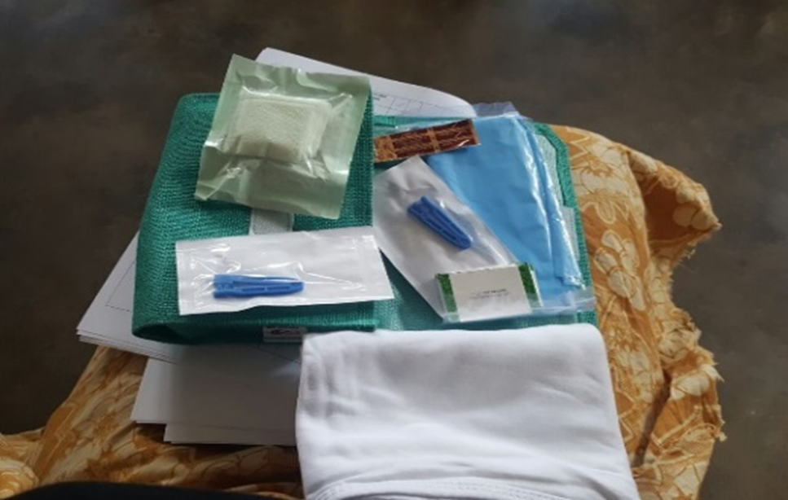
Pilots – feasibility and acceptability
Pilot 1
Pilot 2
+ Video to address beliefs
about efficacy
+ layout change (participatory)
+ Location!
Personal vs.
common bottles
+ Role play to address beliefs
about comparative advantage
vs. water&soap
11 deliveries observed after intervention:
all birth attendants used the birth kits
Those responsible for making kits are doing it every time
Sets left open and unused: in three shifts 0; in two shifts 1
144 HH opportunities observed:
71% compliance before procedures
75% of hand hygiene with Hand Rub; 100% with personal bottles

Slide 61
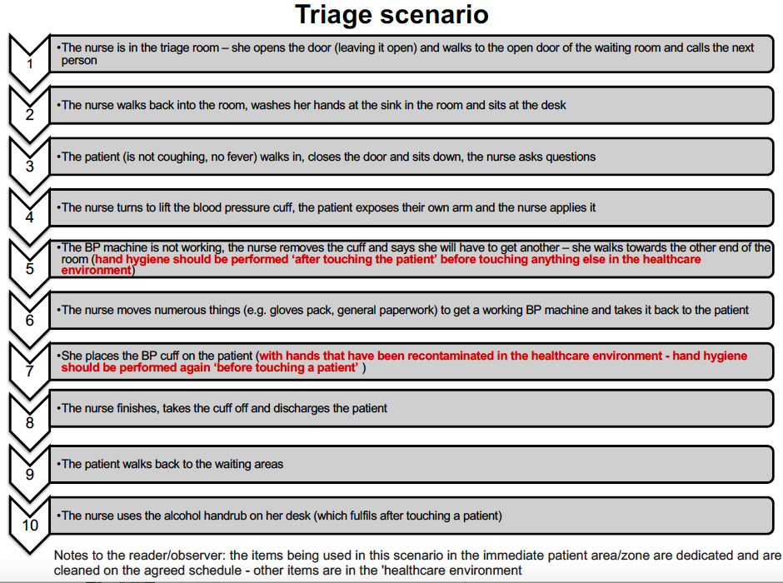
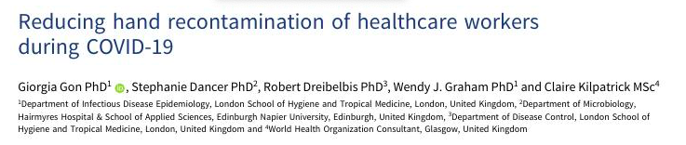
Does recontamination have implications for COVID-19?

Slide 62
Thank you!
Gon G, de Bruin M, de Barra M, Ali SM, Campbell OM, Graham WJ, et al. Hands washing, glove use, and avoiding recontamination before aseptic procedures at birth: A multicenter time-and-motion study conducted in Zanzibar. Am J Infect Control. 2018 Oct 4;
Gon G, Virgo S, de Barra M, Ali SM, Campbell OM, Graham WJ, et al. Behavioural Determinants of Hand Washing and Glove Recontamination before Aseptic Procedures at Birth: A Time-and-Motion Study and Survey in Zanzibar Labour Wards. International Journal of Environmental Research and Public Health. 2020 Jan;17(4):1438.
Cronin WA, Quansah MG, Larson E. Obstetric infection control in a developing country. J Obstet Gynecol Neonatal Nurs JOGNN. 1993 Apr;22(2):137–44.
Yawson AE, Hesse AAJ. Hand hygiene practices and resources in a teaching hospital in Ghana. J Infect Dev Ctries. 2013 Apr 17;7(4):338–47.
Phan HT, Tran HTT, Tran HTM, Dinh APP, Ngo HT, Theorell-Haglow J, et al. An educational intervention to improve hand hygiene compliance in Vietnam. BMC Infect Dis [Internet]. 2018 Mar 7;18.
Spector JM, Agrawal P, Kodkany B, Lipsitz S, Lashoher A, Dziekan G, et al. Improving Quality of Care for Maternal and Newborn Health: Prospective Pilot Study of the WHO Safe Childbirth Checklist Program. PLoS ONE. 2012 May 16;7(5):e35151.
Stewardson AJ, Stuart RL, Egerton-Warburton D, Marshall C, van den Driesen M, Havers S, et al. Determinants of hand hygiene behavior in Australian emergency
departments. In Antimicrobial Resistance and Infection Control; 2017. (Meeting Abstracts; vol. 6(Suppl 3):52).
Wilson J, Prieto J, Singleton J, O’Connor V, Lynam S, Loveday H. The misuse and overuse of non-sterile gloves: application of an audit tool to define the problem. J Infect Prev. 2015 Jan;16(1):24–31.
Stewardson AJ, Stuart RL, Egerton-Warburton D, Marshall C, van den Driesen M, Havers S, et al. Determinants of hand hygiene behavior in Australian emergency departments. In Antimicrobial Resistance and Infection Control; 2017. (Meeting Abstracts; vol. 6(Suppl 3):52).

Slide 63
Questions?
Up Next: Panel Discussion

Slide 64

Panel Discussion
Aarin Palomares
Global Handwashing Partnership
FHI 360
Rx Hand Hygiene: Facilitating Clean Hands

Slide 65

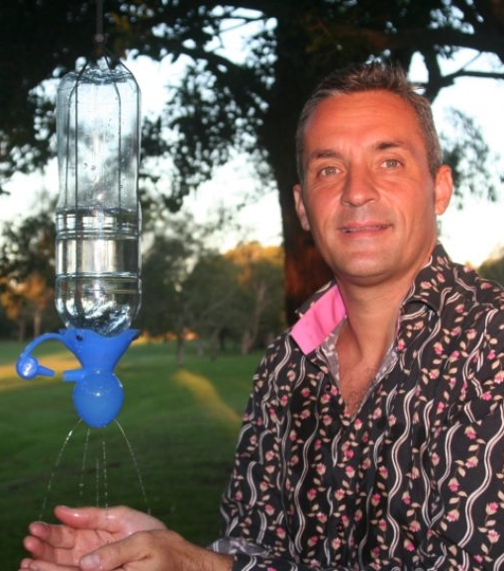


Panel Discussion
Tom Bergin
Healthcare Marketing Director,
Essity
Stuart Mason
CEO,
SPATAP
Geoff Revell
Managing Director,
HappyTap
Pavani Ram
Senior Medical Advisor for Child Health,
USAID
Rx Hand Hygiene: Facilitating Clean Hands
Notes:
Tom Bergin is the Healthcare Marketing Director for Essity Professional Hygiene. Essity produces the Tork® brand of hygiene solutions and systems. Tom leads the go-to-market approach for the healthcare segment with a focus on market insights, innovation and portfolio management. He has been with Essity since 2008 and has both product and segment management experience across a range of products and market segments.
Stuart is the CEO and inventor of the multi-award-winning SPATAP Portable Tap, he is a WASH Professional, qualified trainer and hygiene educator specializing in handwashing behavior change and running handwashing and hygiene projects in the South Pacific region.
Geoff is the founder and Managing Director of a group of WASH social enterprises: HappyTap Vietnam & Bangladesh, and WaterSHED in Cambodia. These enterprises deliver a range of aspirational products and services designed to increase safe WASH behaviors.
Dr. Pavani K. Ram is a Senior Medical Advisor for Child Health at USAID. After her training in internal medicine, Dr. Ram completed the Epidemic Intelligence Service Program and served as a medical epidemiologist at CDC, focusing on enteric infections, including outbreak investigations and prevention through improved water quality. In 2005, she transitioned to a faculty position at the State University of New York at Buffalo, where she expanded her work on environmental exposures associated with childhood infections, especially handwashing. Her public health practice and scholarship experience in child survival has drawn on diverse methods, including epidemiology, social and behavior change, and environmental health. Dr. Ram was the founding Director of the University at Buffalo's Community for Global Health Equity. Since 2017, Dr. Ram has served as a Senior Medical Advisor for Child Health in USAID's Office of Maternal and Child Health and Nutrition, where she is a focal point for infection prevention among newborns and young children.

Slide 66
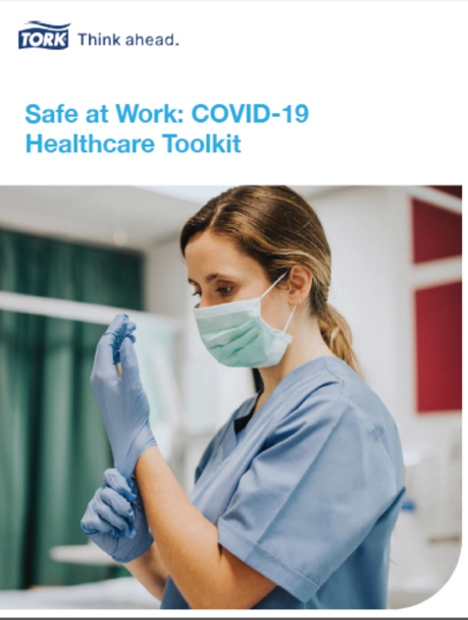
Tork, an Essity brand
The global leader in professional hygiene
Tork Hygiene Solutions
Tork Safe at Work Toolkit
Tork systems help you to improve hygiene, enhance image, reduce usage and waste, and protect the environment.
Downloadable toolkit with tools, resources, and knowledge to help support businesses in creating safer working environments.
Free download available on www.torkglobal.com or www.torkusa.com/safeatwork
Tools & Resources Included:
Hand Hygiene Resources
Hand wash and hand rub procedures
Tork Virtual Reality Clean Hands Training App
Tork poster builder for hygiene signage
Surface Cleaning Resources
Dispenser Placement Guide
66
Notes:
Tork is the global professional hygiene brand of Essity, and a committed partner to customers in over 110 countries.
The Tork brand offers professional hygiene products and services to customers worldwide ranging from restaurants and healthcare facilities to offices, schools and industries.
Our products include dispensers, paper towels, toilet tissue, napkins, wipers, and hand soap/sanitizers; as well as software solutions for data-driven cleaning. Through expertise in hygiene, functional design and sustainability, Tork has become a market leader that supports customers to think ahead so they’re always ready for business.
As global experts in professional hygiene, we want to support workers on the front line with information on how to minimize contagion by maintaining proper hygiene practices in the workplace. Following proper hand hygiene protocols, routine cleaning and disinfecting procedures, and optimizing dispenser placement can help reduce the spread of the virus that causes COVID-19 in your healthcare facility and prevent sepsis. This toolkit provides the resources you need to help you reinforce those best practices in your healthcare facility during this outbreak and beyond.

Slide 67
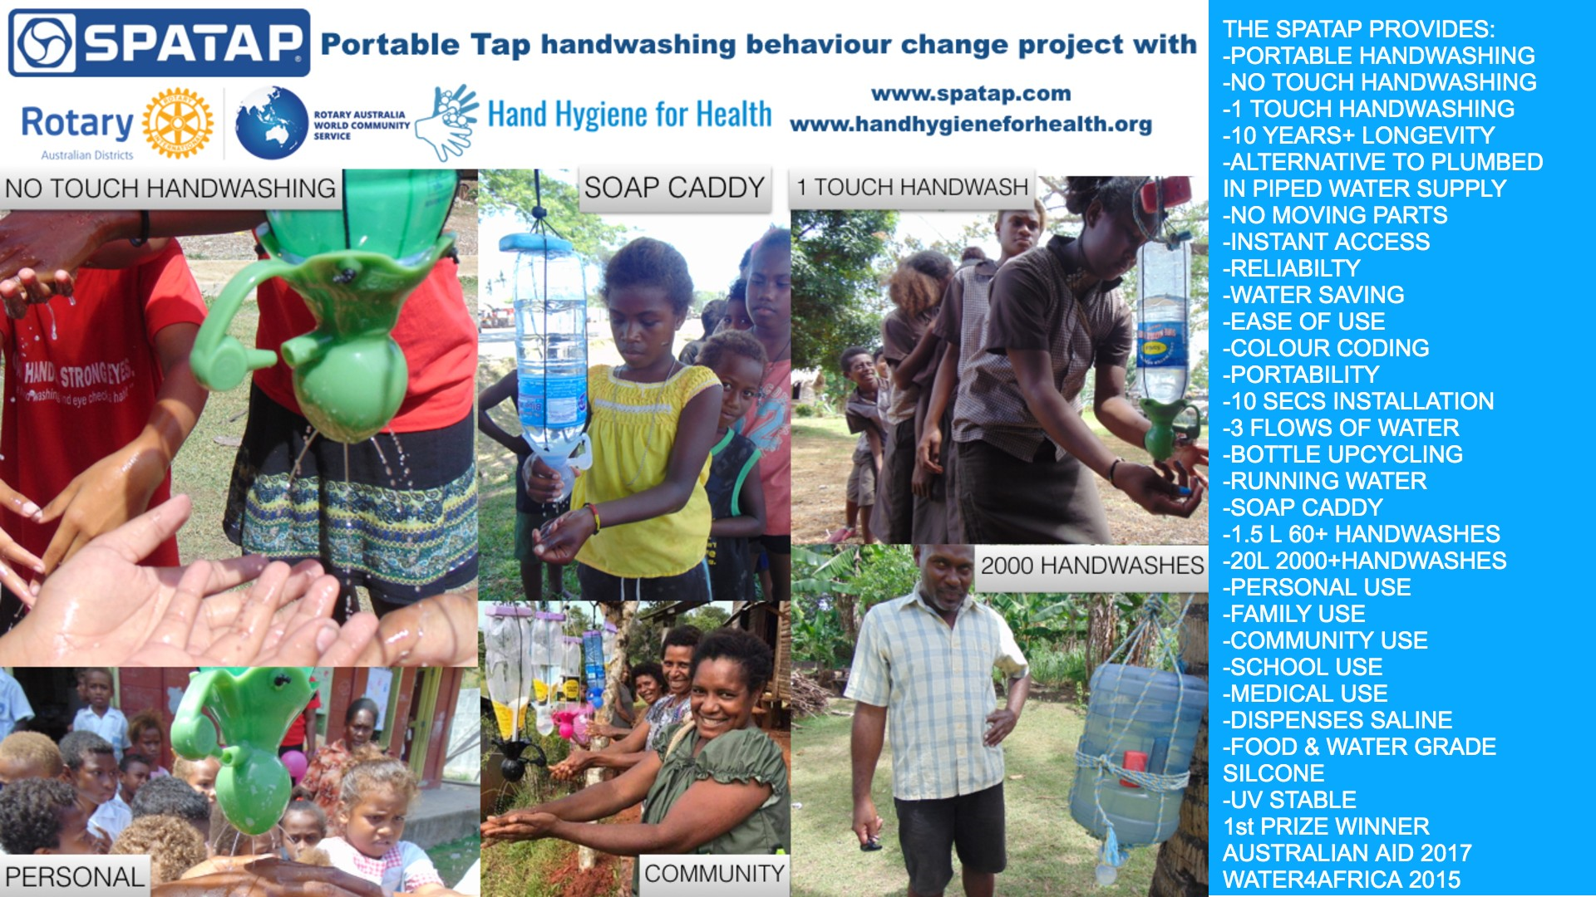

Slide 68

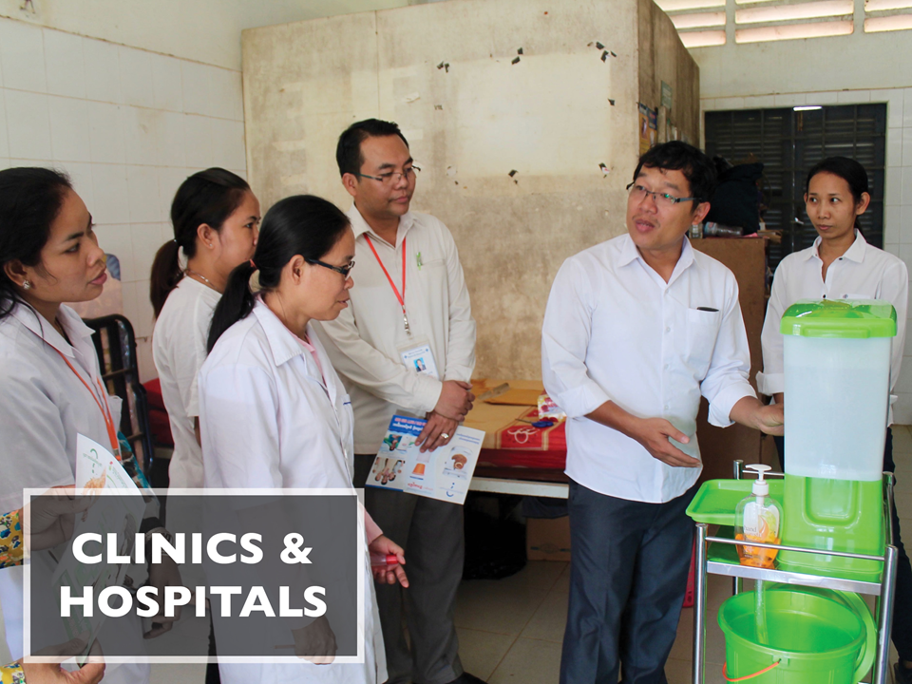
User-friendly, portable
handwashing stations
Portable: Place exactly where needed for washing at critical times in homes, schools, health clinics, and quarantine sites.
e.g. between every 3 beds, in consultation rooms, in patient waiting areas, etc.
Water-efficient: Low-flow tap allows 50-70 uses per fill; 10 devices give 500-700 washes
Rapid deployment: Mass production, low-cost, nested packing, & quick setup means all HCFs could be equipped within near term
Behavior Change: research-based design meant to to nudges consistent handwashing and habit formation; commitment by HCF Director is important no matter which facility
Social enterprise: Building a market for sustainable access to handwashing
More info: https://happytap.net/en

Slide 69
Panel Discussion
Tom Bergin
Healthcare Marketing Director,
Essity
Stuart Mason
CEO,
SPATAP
Geoff Revell
Managing Director,
HappyTap
Pavani Ram
Senior Medical Advisor for Child Health,
USAID
Rx Hand Hygiene: Facilitating Clean Hands

Slide 70

Closing Remarks
Lindsay Denny
Emory University
Global Water 2020
Rx Hand Hygiene: Facilitating Clean Hands

